Slide 1

Software configuration management
Empire Hotel: Online reservation system
For lecturer nurul sharaz binti azmanuddin
Muhammad Faid Luqman Bin Nor Hasni, 52213218086
Syifa’Ul Husna Binti Halim, 52213218074
Faizah Chaibou Issoufou, 52213218138

Slide 2

Project Background
System Scope
EmpireHotel
Online Hotel Reservation System
Developed in 2015
via PHP and MySQL
View hotel information
Make a reservation
Manage reservation, gallery and room information
Check transaction
Print Reservation Details

Slide 3

System Objectives
To provide 24 hours online reservation service.
To speed up the reservation process.
To maximize productivity and sales.
To provide flexibility to the customer
To manage the reservation efficiently.
To reduce the manual workload
To advertise hotel via online

Slide 4

Rebrand and enhance the outdated online system
Fix the current bugs
Along with additional feature
Current
Project Purpose

Slide 5
Project Cost
No | Software Name | Description | Cost (RM)
1 | Microsoft Office Professional Plus 2019 | For managing documentation and presentation | RM 2,399
2 | Microsoft Project 2019 | For creation of Gantt Chart | RM 2,899
3 | Microsoft Visio 2019 | For creation of UML Diagram | RM 2,899
4 | Adobe Illustrator CC 2019 | For creation of necessity 2D vector graphics | RM 1,130.43
5 | Google Chrome | For browsing and downloading files | Freeware
6 | MySQL & PHP | Database management tool/system to manage data | Freeware
TOTAL COST (Software) |  |  | RM 9,327
No | Hardware Name | Description | Cost (RM)
1 | 3 Laptop GX503 | This is the main devices that is use develop the mobile app | RM 3,500 x 3 = RM10,500
3 | HP LaserJet Pro M15w Printer | This printer device is use to print all of the necessary papers including AR marked paper. | RM 399
Other Requirements
5 | Unifi 100mbps | Internet is used for development | RM129 per month = RM 774
6 | Electricity & Water | Usage of electric and water | RM400 per month = RM 2400
TOTAL COST (Hardware & Book) |  |  | RM 11,673
No | Human Resources Name | Cost (RM)
1 | Project Manager | RM 7,000
2 | Web Developer & Web Designer | RM 5,000
3 | System Analyst & Tester | RM 5,000
Total Cost (Human Resources) |  | RM 23,000 x 6 Months = RM102,000
TOTAL COST (RM) include all | RM 123,000

Slide 6

New Expected Version
Due-date: 3 October 2020 Date Completed: 3 October 2020
ID | Type | Change request | Duration | Status
CR1 | D | Revamp print button | 4 days | Completed
CR2 | N | Add search capabilities for admin | 7 days | Completed
CR3 | N | Add more bank type option | 4 days | Completed
CR4 | N | Add message box for additional information and request of reservation | 5 days | Completed
CR5 | E | Refine payment approach | 3 days | Completed
CR6 | E | Refine website design | 30 days | Completed
CR7 | N | Add validation for room selection when reserving room | 6 days | Completed
Note: D = Defect, N = New Functionality, E = Enhancement

Slide 7
New Expected Version
Due-date: 3 October 2020 Date Completed: 3 October 2020
ID | Type | Change request | Duration (Days) | Status
CR8 | N | Add Login for customer | 15 days | Completed
CR9 | N | Add Register for customer | 20 days | Completed
CR10 | N | Add Logout for customer | 2 days | Completed
CR11 | N | Add reservation history | 6 days | Completed
CR12 | N | Add status confirmation for Admin (Cancel, Confirm, Complete Booking) | 5 days | Completed
CR13 | N | Add room cancellation | 5 days | Completed
CR14 | E | Refine navigation bar in term of its button | 3 days | Completed
CR15 | N | Add manage bank accounts for admin | 6 days | Completed
CR16 | N | Add validation for login and register | 10 days | Completed
Note: D = Defect, N = New Functionality, E = Enhancement

Slide 8
configuration management PROCESS CONDUCTED
PROCESS
CONFIGURATION
MANAGEMENT
Aim: Manage, organize, and control the changes being done to the system and documents as well as to reach a maximum productivity with minimum mistakes.
Team: CM manager, project leader, Developer, Auditor, IT lead or stakeholder
Input: Software artefacts, change request form
Outcome: Versioning, configuration report, baseline and SCM plan
Configuration Identification
Identify what to be controlled
Configuration Control
Request, Evaluate, and Approve change
Configuration Status Accounting
Configuration status information
Software library to include
Configuration status reporting

Slide 9

Old Process Flow (Customer)

Slide 10
New Process Flow (Customer)

Slide 11
Old Process Flow (Admin)

Slide 12
New Process Flow (Admin)

Slide 13

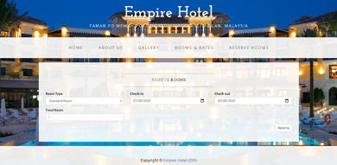
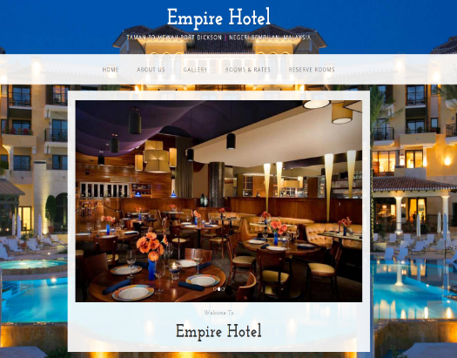
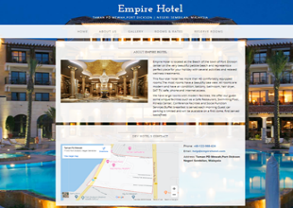
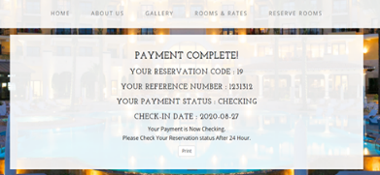
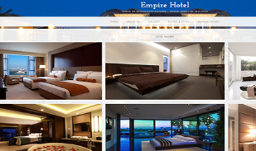
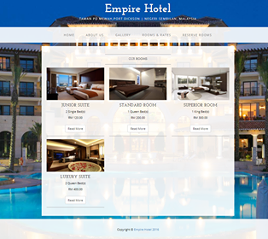

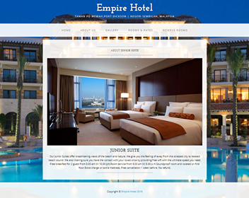
CR #6
(Website Design)

Slide 14
CR #8, CR #9, CR #10, CR #14 and CR #16
No Login, Logout, Register and their validation
Login and Register need to be added as button in navigation bar

Slide 15
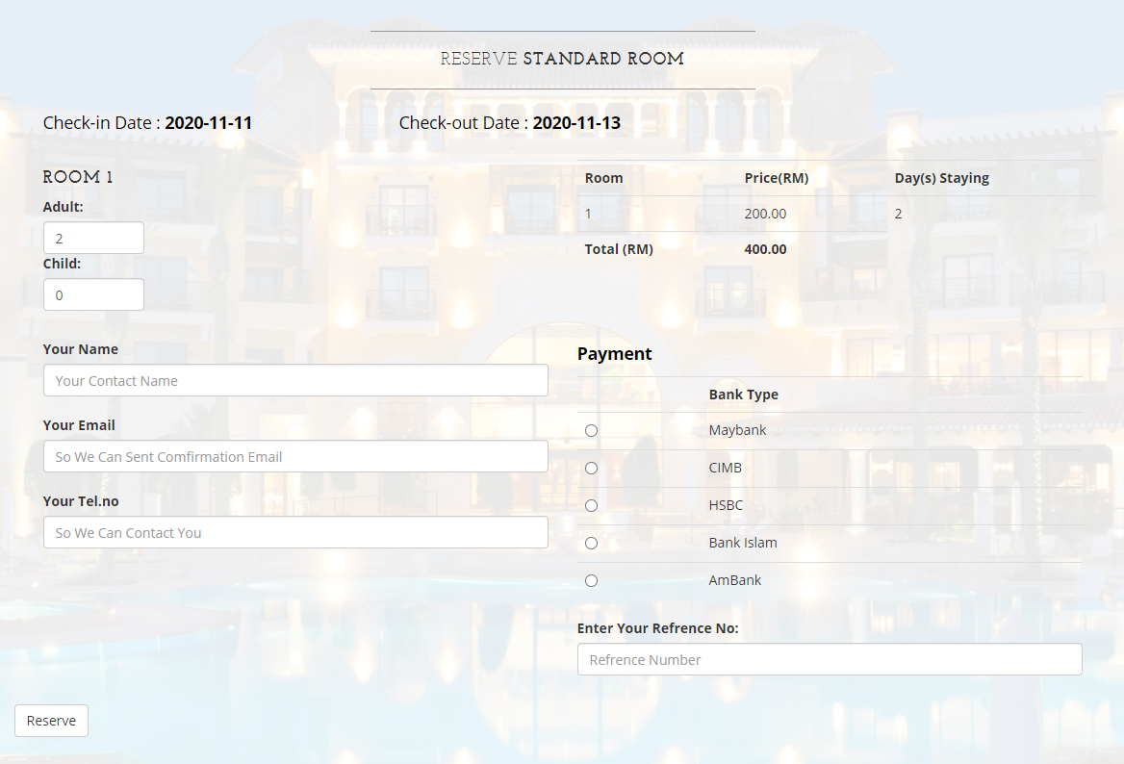
CR #3, CR #4 and CR #7
(Limited bank options, no message box for special request and no validation for reservation form)

Slide 16
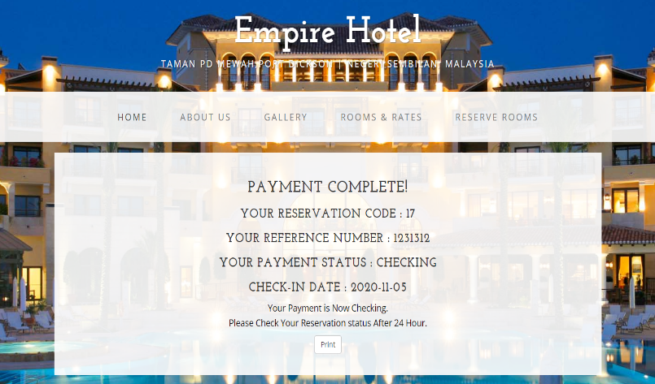
CR #1
(Print button not working/obsolete)

Slide 17
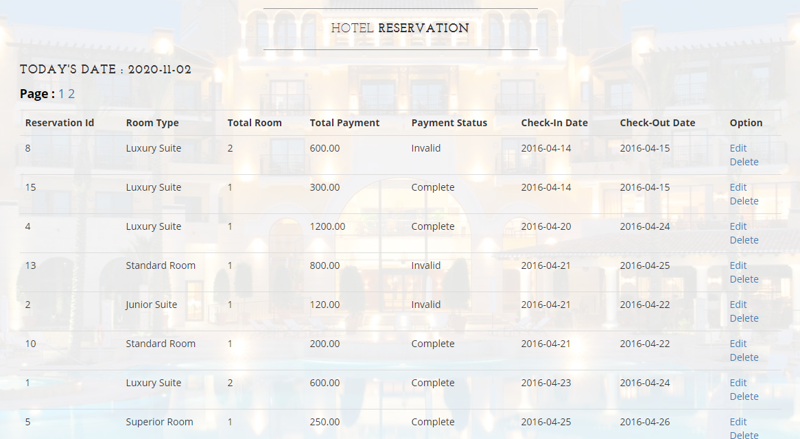
CR #2
(No searching capabilities – manual search relied on paging number)

Slide 18
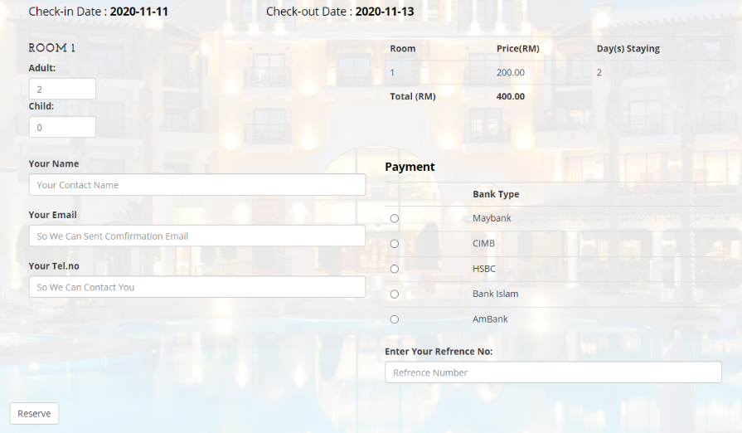
CR #5
(Outdated Payment Process – Can’t pay on website)

Slide 19
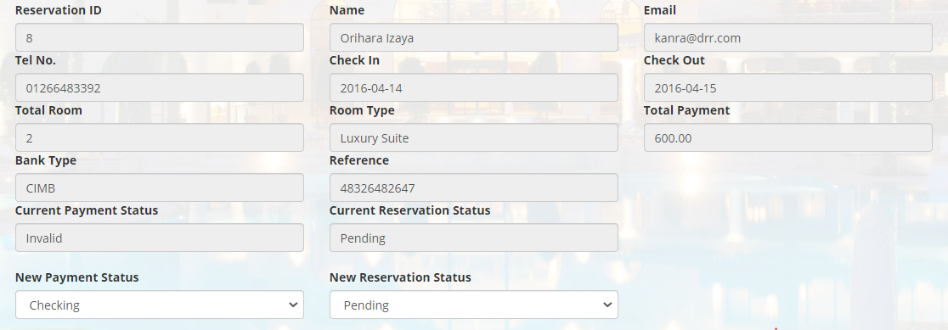
CR #11
(No reservation history feature for customer to check for past transaction)
CR #13
(No room cancellation feature for customer to cancel reservation)
Admin Side only

Slide 20
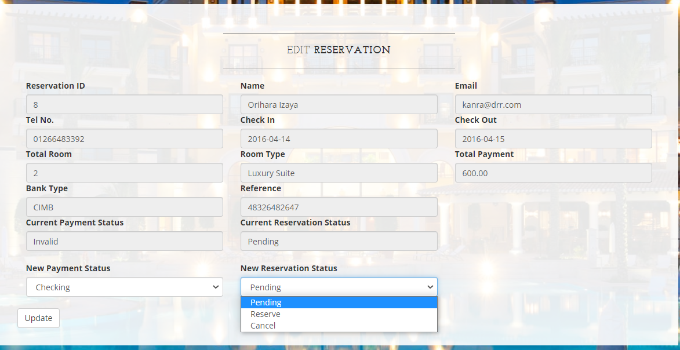
CR #12
(Add and Refine Reservation Status)
Admin Side only

Slide 21
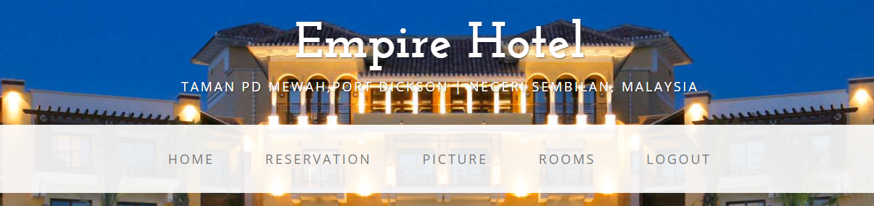
CR #15
(No manage bank option to add, update and delete bank)
Admin Side only

Slide 22

New Website (Video Demo)

Slide 23
GitHub (Video Demo)

Slide 24
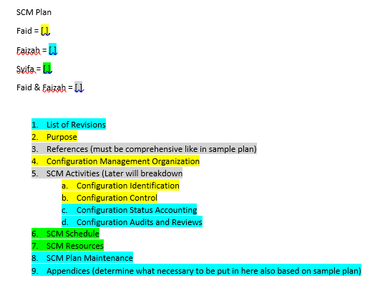
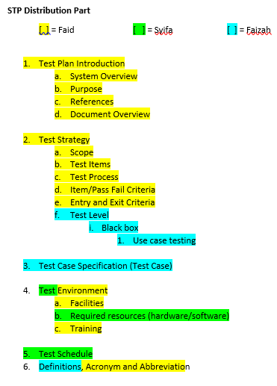
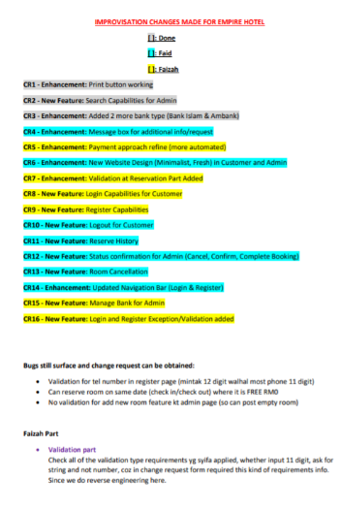
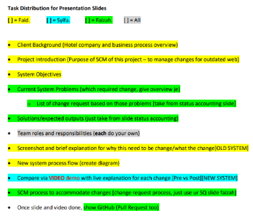
Task distribution documents created and assigned by Faid
Overall the members did excellent works based on their expertise.
[ ] Syifa - did all the coding part

Slide 25
Muhammad Faid Luqman Bin Nor Hasni (Project Manager)
Roles, Responsibilities and Tasks
Consist of
Assign and distribute all work tasks in project systematically and equally according to their expertise.
Create a guidelines and distribution document for all works
Plan the schedule to complete task
Write SCM Plan part:
Introduction (Document Overview, Purpose, Acronyms, References)
Organization
Configuration Identification
Configuration Control
Write STP Plan part:
Test Plan Introduction (System Overview, Purpose, References, Document Overview)
Test Strategy
(scope, test items, test process, item/pass fail criteria, exit/entry criteria)
Test Environment
(Facilities and Training)
Acronym and Abbreviation
Review all the work that each team member do for SCM plan, Change Request, GitHub and especially Web Prototype. I will approve or demand revision.
Amend some part up to my standards.
Also add 8 Change Request and amend 1 Minutes of Meeting up to my standards.
Manage Github
along with Faizah
Create some announcement post.
Facilitate few branch
Do Status Accounting Slide
Check and Reply post in GitHub
Proposal (Assignment 1)
Compile all documentation

Slide 26
Faizah Chaibou Issoufou | Faizah Chaibou Issoufou
Role | Software Configuration Manager
Task done | Minutes of meeting CR form Submit CR on GitHub SCM plan Review and check SCM plan Proposal (ASSG1) | 3 minutes 8 CR form 17 submissions List of revisions, References, Definitions, Status accounting, SCM maintenance, Appendices
Task to do | STP – Test specification + Test level (Completed)
Rating | 5/5

Slide 27

Name | Role | Task Done | Task To Do | Rating
Syifa’Ul Husna Binti Halim | Developer | -Fixing and upgrading system based on CR (All programming work) -SCM project proposal -Creating GitHub repository information -SCM Plan resource and schedule -Week 7 status accounting -Proposal (ASSG1) | -STP - Update GitHub on project progress regularly -SCM Plan | 5/5

